Slide 1

Exception Handling

Slide 2
Errors -
Errors can be broadly categorized into two types. We will discuss them one by one.
Compile Time Errors
Run Time Errors
Compile Time Errors – Errors caught during compiled time is called Compile time errors. Compile time errors include library reference; syntax error or incorrect class import.
Run Time Errors - They are also known as exceptions. An exception caught during run time creates serious issues.

Slide 3
Exception Handling –
Exception Handling in C++ is a process to handle runtime errors. We perform exception handling so the normal flow of the application can be maintained even after runtime errors.
In C++, exception is an event or object which is thrown at runtime.
All exceptions are derived from std::exception class. It is a runtime error which can be handled. If we don't handle the exception, it prints exception message and terminates the program.
Advantage - It maintains the normal flow of the application. In such case, rest of the code is executed even after exception.

Slide 4
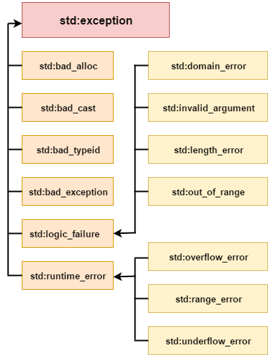
Exception Classes -
In C++ standard exceptions are defined in <exception> class that we can use inside our programs. The arrangement of parent-child class hierarchy is shown below –

Slide 5
Exception | Description
std::exception | It is an exception and parent class of all standard C++ exceptions.
std::logic_failure | It is an exception that can be detected by reading a code.
std::runtime_error | It is an exception that cannot be detected by reading a code.
std::bad_exception | It is used to handle the unexpected exceptions in a c++ program.
std::bad_cast | This exception is generally be thrown by dynamic_cast.
std::bad_typeid | This exception is generally be thrown by typeid.
std::bad_alloc | This exception is generally be thrown by new.
NOTE: In C++, we use 3 keywords to perform exception handling -
try
catch
throw

Slide 6
Try/catch Example -
#include<iostream.h>
#include<conio.h>
float division(int x, int y)
{
if( y == 0 )
{
throw "Attempted to divide by zero!";
}
return (x/y);
}
void main ()
{
int i = 25;
int j = 0;
float k = 0;
try
{
k = division(i, j);
cout << k << endl;
}
catch (const char* e)
{
cerr << e << endl;
}
}

